Slide 1

Data Shuffle

Slide 2
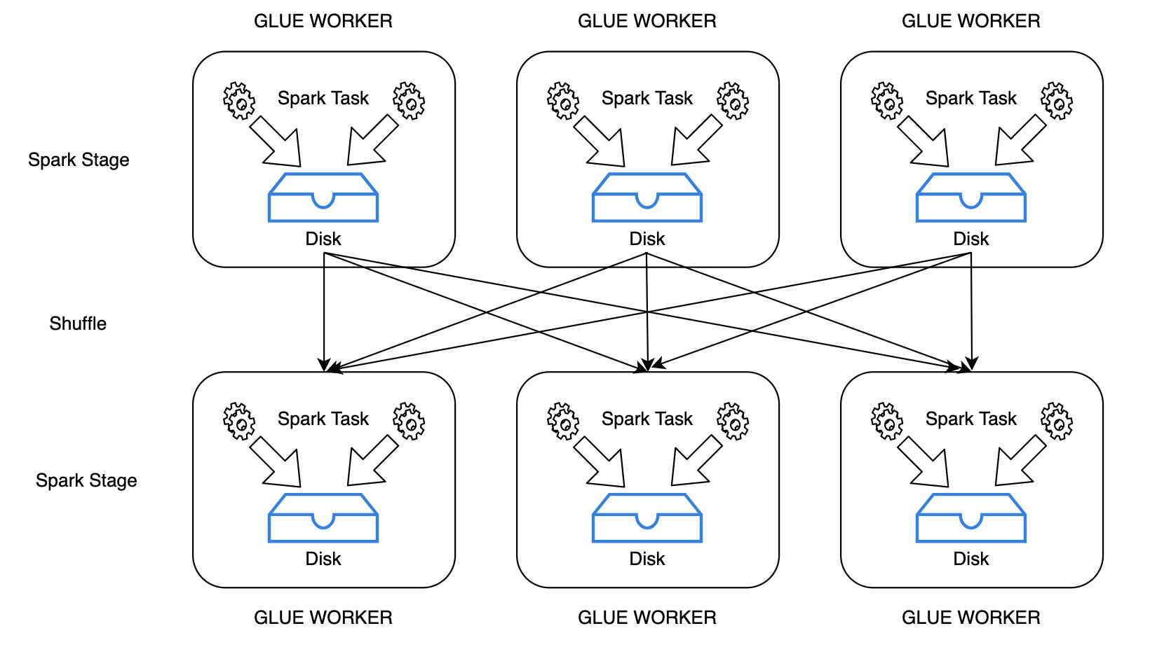
What is Data Shuffle?
Process of redistributing data across a node
Used to group related data
Required to aggregate of join data based on a key
Partition based on a key within the node, then aggregated / processed
Shuffling is expensive which can be a bottleneck

Slide 3
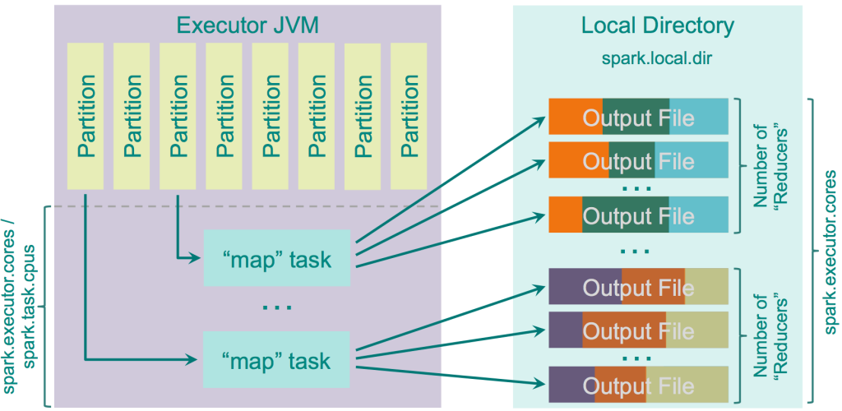
Data Shuffling
Source - https://0x0fff.com/spark-architecture-shuffle/

Slide 4
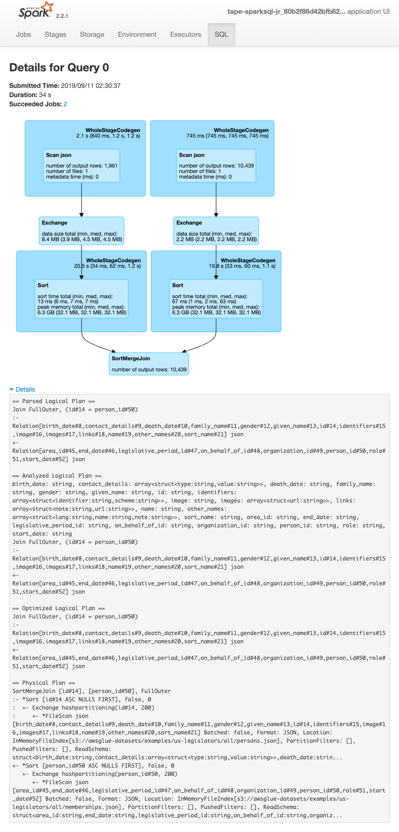
Optimizing
Reduce input data, using pre-filters or pushdown predicates
Work with Partitioned data
Analyze potential params:
e.g. spark.sql.shuffle.partitions
More-advanced options in next series

Slide 5
Next…

